Slide 1
Geometric Series

Slide 2
Geometric Series
Each term is obtained from the preceding number by multiplying by the same number r.
Find r (the common ratio)

Slide 3
Is a Geometric Series
Where a = first term and r=common ratio
Write using series notation

Slide 4
The sum of a geometric series
Sum of n terms
Multiply each term by r
subtract
Geometric series converges to
If r>1 the geometric series diverges.

Slide 5
Find the sum of a Geometric Series
Where a = first term and r=common ratio
The series diverges.

Slide 6
Repeating decimals-Geometric Series
The repeating decimal is equivalent to 8/99.

Slide 7
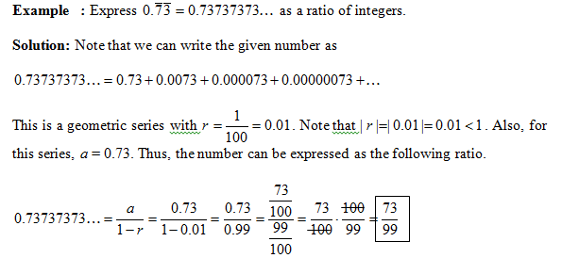

Slide 8
Convergence or Divergence?

